Slide 1
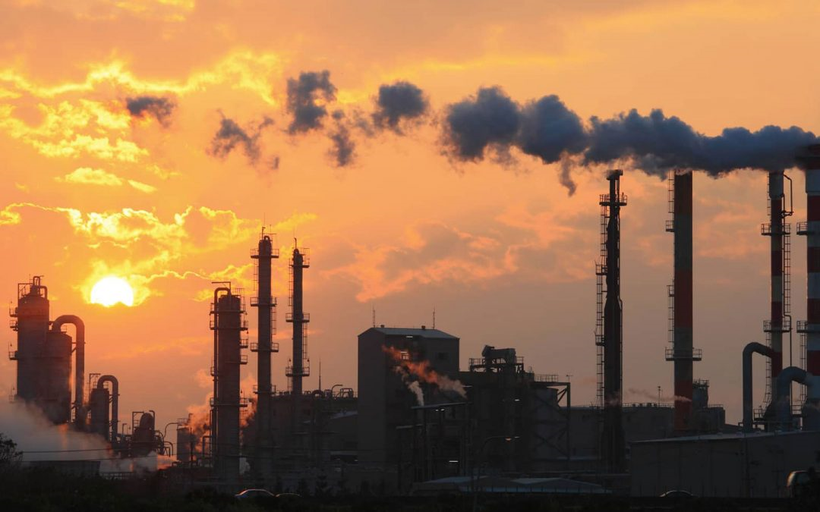
INDIA AIR QUALITY DATA ANALYSIS

Slide 2
AIM:-
The main aim of this project is to identify and analyze the amount of pollutant present in the air and show how much impact that particular pollutant is effect on human effect like(healthy,moderate etc,,)
Show these all in the form of the using visulization forms.

Slide 3
ABSTRACT:-
Examining and protecting air quality has become one of the most essential activities for the government in many industrial and urban areas today.
We know that as world is developing rapidly there was lot amount of researches in air and different kinds of liquids are being released in the air which are affect for human heath that is which iis called as air pollutants.

Slide 4
INTRODUCTION:-
In the developing countries like India, the rapid increase in population and economic upraising in cities have lead to environmental problems such as air pollution, water pollution, noise pollution and many more
Air pollution has direct impact on humans health .There has been increased public awareness about the same in our country
Global warming, acid rains, increase in the number of asthma patients are some of the long-term consequences of air pollution.
Hence, enhancing air quality forecasting is one of the prime targets for the society sulphur dioxide is a gas. It is one of the major pollutants present in air

Slide 5
Features we will deal with :-
-->City -->Date -->PM2.5 (Particulate Matter 2.5-micrometer) -->PM10 (Particulate Matter 10-micrometer) -->SO2 (Sulphur Dioxide) -->NOx (Any Nitric x-oxide) -->NH3 (Ammonia) -->CO (Carbon Monoxide) -->O3 (Ozone or Trioxygen) -->Benzene -->Toluene -->Xylene -->AQI -->AQI_Bucket

Slide 6
BREIF:-
SO2(sulphur dioxide)
Which is one the most air pollutant which we are seeing as a major air pollutant in the air as we know that world is developing fast and as population is increasing so we are getting this air pollutant from gas industry,petroleum etc,,,
100 parts of so2 is safe for million air pollutants.
BTX refers to the chemicals benzene, toluene,xylene which are found in sea which was found due to petroleum deposits etc.

Slide 7
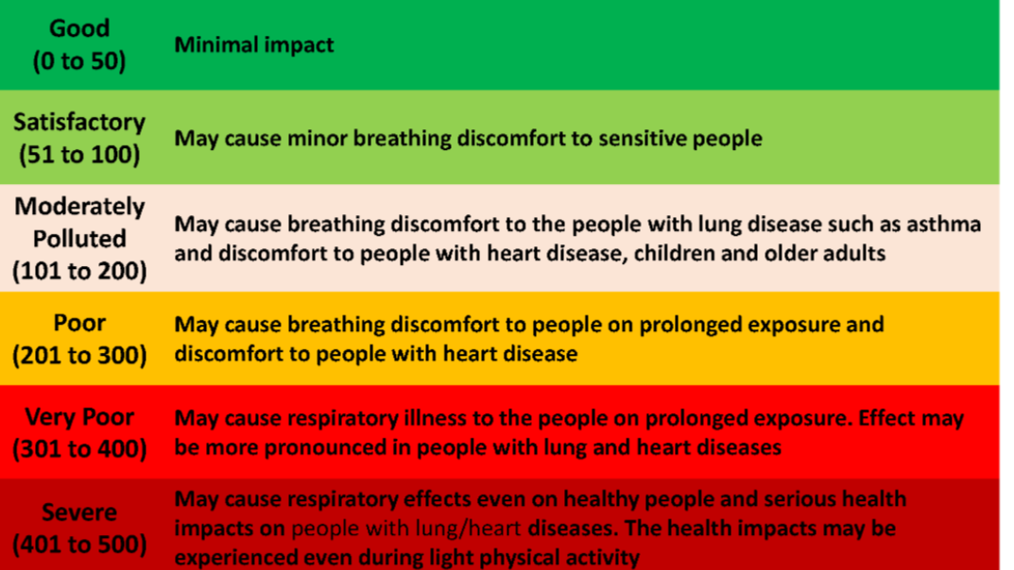
AQI_Bucket

Slide 8
RELATED WORK:-
In this research paper the students have forecasted the air quality of India by using machine learning algorithms to predict the air quality index(AQI) of a given area. Air quality Index is a standard measure to determine the quality of air. Concentrartion of Gases such asso2, no2,co2, rspm, spm. etc. are recorded by the agencies

Slide 9
https://iopscience.iop.org/article/10.1088/1742-6596/1813/1/012031/pdf
https://www.researchgate.net/scientific-contributions/Mihaela-Oprea-70854786
https://www.tandfonline.com/doi/full/10.1080/10962247.2020.1772406

Slide 10
ALORITHUMS:-
We will use data visulization that is some kind of graphs inorder to show how much amount of different kinds of pollutants are present in atmosphere which effects.
Random Forest
AQI

